Slide 1


OpenWeatherMap and Spotify API Integration
How does weather influence music choice?
Willson Camp

Slide 2
Premise
Objectives
Integrate music and weather APIs to get and store daily data in a database
Use Tableau to create relational analytics regarding musical artists and weather
Challenges
Lots of outdated and paid-only data returns
Normalizing data in JSON format
API connections
documentation of the APIs is unclear
Keys needing to be re-generated after a week or so

Slide 3
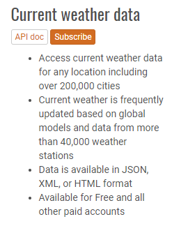
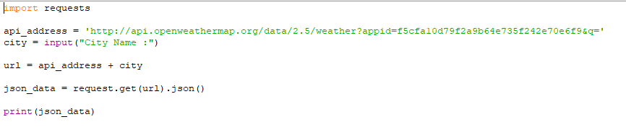
Connections: OpenWeatherMap
Scope of the project was narrowed to only the month of April, 2018
As with all APIs, once signing up with OpenWeather, a key is accessible from your account
Integrate your key with the base URL of the web API
Create a simple python program surrounding city request, in our case, Philadelphia

Slide 4
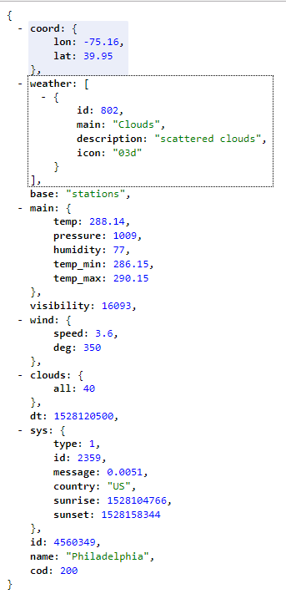
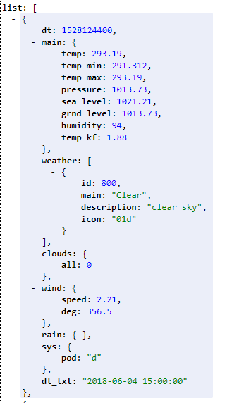
Data Returns: OpenWeatherMap
coord
coord.lon City geo location, longitude
coord.lat City geo location, latitude
weather (more info Weather condition codes)
weather.id Weather condition id
weather.main Group of weather parameters (Rain, Snow, Extreme etc.)
weather.description Weather condition within the group
weather.icon Weather icon id
base Internal parameter
main
main.temp Temperature. Unit Default: Kelvin, Metric: Celsius, Imperial: Fahrenheit.
main.pressure Atmospheric pressure (on the sea level, if there is no sea_level or grnd_level data), hPa
main.humidity Humidity, %
id City ID
name City name
cod Internal parameter

Slide 5
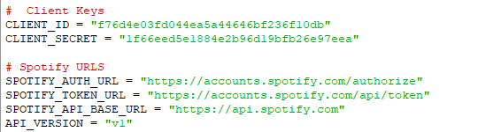
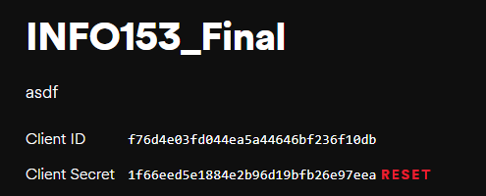
Connections: Spotify Web API
Entered client ID, client secret ID, account user ID, and the base api url
Entered a redirect uri, which is a way of authenticating my client
Redirects you to your uri you input, and the API service adds its own special ID, all of which must be pasted into the program before authentication (pictured on the next slide)
For anyone looking to use the Spotify API in conjunction with Python, the 'Spotipy' library is very helpful, and I used it a lot during this project
Spotipy can be install easily using 'pip install spotipy'

Slide 6
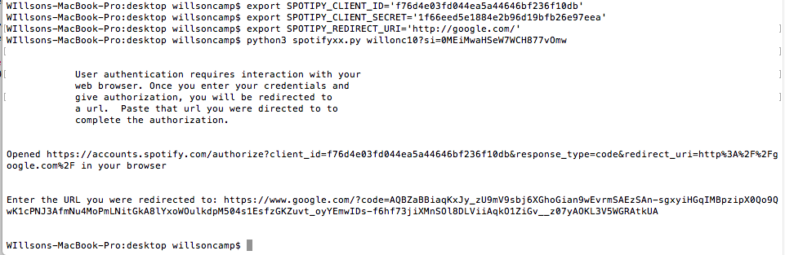

Slide 7
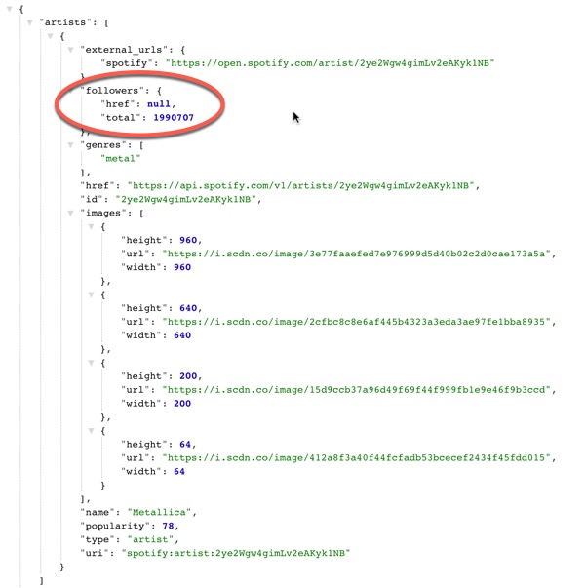
Data Returns: Spotify
Pictured right: and example general call of the artist "Metallica"
When using the 'artist:general' call, a few things are returned:
External urls (to Spotify website)
Followers
Genre
Href (website profile url)
Id
Images (and their links)
Name
Popularity rating (calculated monthly via a Spotify homebrew algorithm)
Type
URI
For my project, I mostly used 'playlist:' calls, invoking a playlist called 'Spotify's Global Top 50'
Along with general information, this playlist would order the hottest tracks each day that month - April of 2018

Slide 8
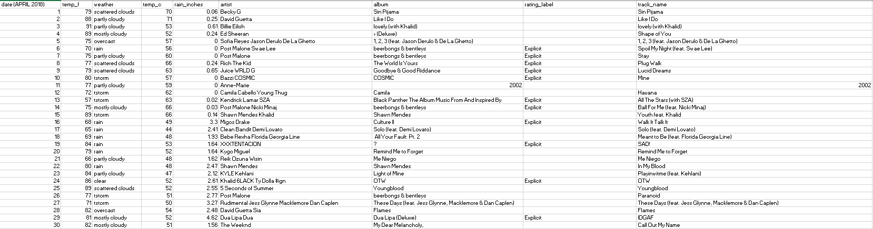
JSON —> Excel
JSON2xlsx 1.3 - python module
pip install json2xlsx

Slide 9
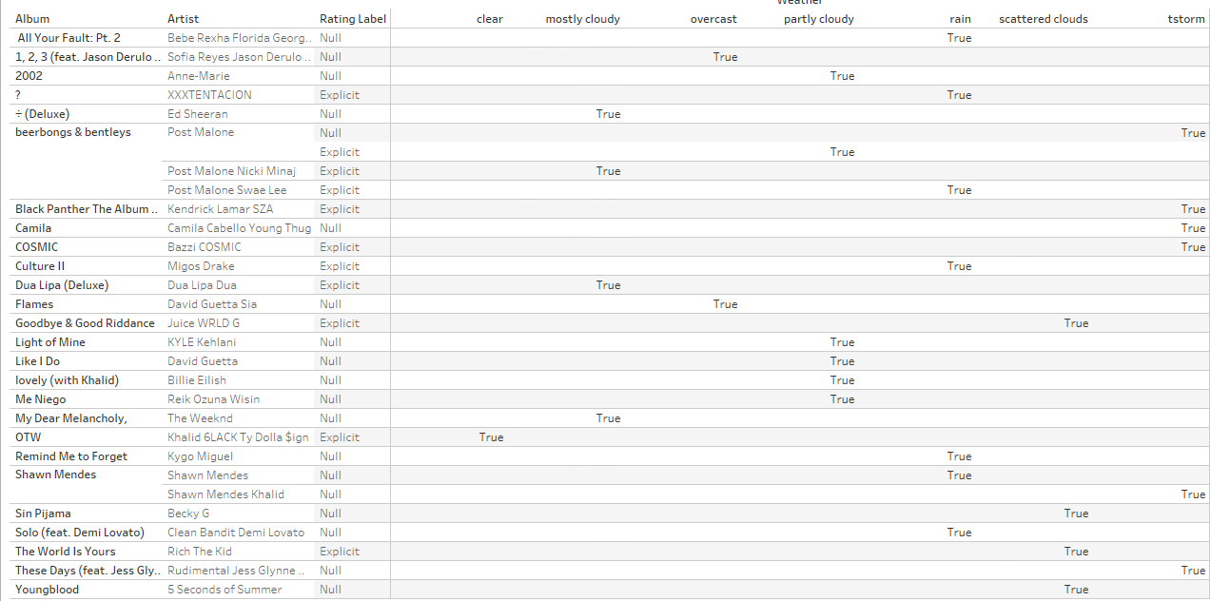

Slide 10
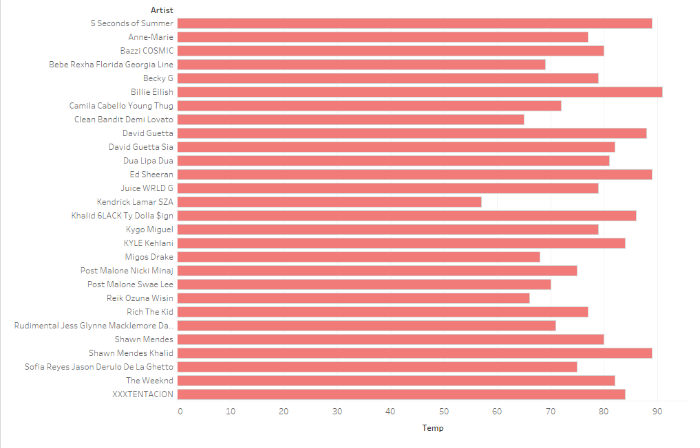

Slide 11
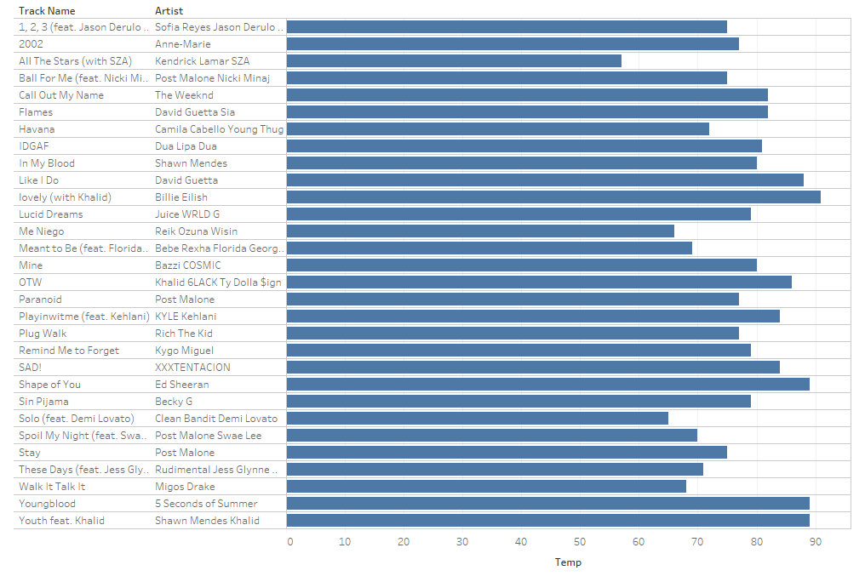

Slide 12
Questions?

